Slide 1

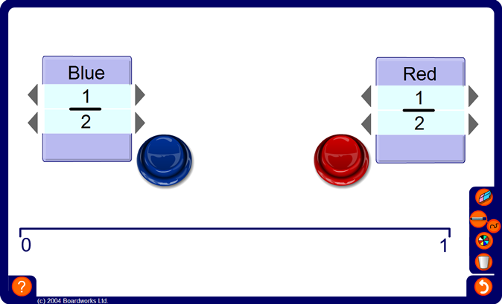


Connect three fractions
Notes:
Divide the class into two teams. Each team selects a team leader to stand at the board and enter the agreed values.
Decide which team will start and ask them to enter a fraction less than 1. The numerator can be between 1 and 9 and the denominator can be between 1 and 10. Members of the team may put up their hands and advise them where to start.
Calculators are not allowed.
A cross corresponding to the chosen fraction will appear on the number line.
It is then the turn of the other team. They, too, must enter a fraction on the number line following the advice of their team members.
The winner is the first team to get three of their crosses together in a row.
Discuss tactics as the game progresses. This will involve converting the fractions to decimals or percentages in order to compare them. Pupils will need to decide how to block their opponent by, for example, placing their crosses between their opponents crosses.

